Slide 1
EDGE COMPUTING

Slide 2
When Edge Computing was introduced?
The origin of edge computing can be traced back to the 1990s, when Akamai launched its content delivery network (CDN). The idea back then was to introduce nodes at locations geographically closer to the end user for the delivery of cached content such as images and videos.
Cloud computing attracted particular attention in 2006.
Edge Computing was one of the top technology trends in 2018.

Slide 3
Why Edge Computing was introduced?
Cloud Computing __ by which remote servers hosted on the Internet, store and process data, rather than local servers or personal computers __ is ready to move to the next level (Edge Computing).
In the past, companies would send all of their monitoring data into the cloud or to a corporate data center for processing, analysis and storage. As the IoT has grown, however, the volume of data makes this approach impractical. This is where edge compute enters the picture.

Slide 4
Why (continued)
To enable faster response times, lower latency (ability to process very high volumes of data with minimal delay), and simplified maintenance in computing.
This is where Edge Computing comes in __ which may see as an extension to the cloud, but which is, in fact, different in several basic ways.
The primary reason for the growth of edge compute is efficiency. All of that collected data needs to be processed somewhere. And as the volume of IoT data has increased, more and more of the processing is taking place at the edge.

Slide 5
What is Edge Computing?
Edge computing enables data to be analyzed, processed and transferred at the edge of a network.
The idea is to analyze data locally, closer to where it is stored, in real time without delay, rather than send it far away to a centralized data center.
Edge Computing offloads data from cloud, so that physical distance between customer and cloud is minimized
In this way, there will be faster response time, and there will be no delay in accessing that data.

Slide 6
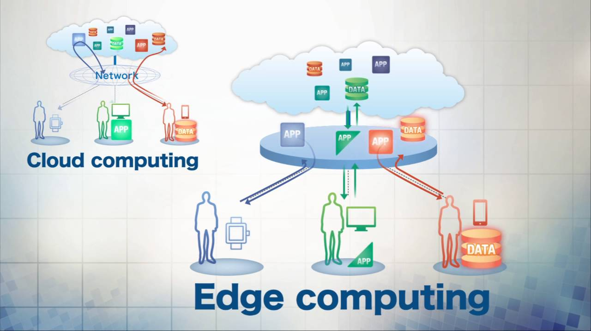

Slide 7
How Does Edge Computing Work?
Edge computing works by capturing and processing information as close to the source of the data or desired event as possible. It relies on sensors, computing devices and machinery to collect data and feed it to edge servers or the cloud.
Organizations migrate to an edge model with IoT devices, there’s a need to deploy edge servers, gateway devices and other gear that reduce the time and distance required for computing tasks—and connect the entire infrastructure. Part of this infrastructure may include smaller edge data centers located in secondary cities or even rural areas

Slide 8
Working(continued)
In order for IoT devices to deliver real value, there must be a way to connect the edge to the cloud and corporate data centers.
A gateway manages the flow of data between the edge network and a cloud or data center.
For example, routers, routing switches, etc.

Slide 9
Benefits of Edge Computing
Reduced Latency: Very less delay time
Reduced Bandwidth: Because more data is processed, analyzed, and stored locally, less data is sent to the cloud.
Security: Edge computing means less data is centralized in cloud storage. By processing and storing some data in an edge network, the situation of having “all your eggs in one basket” is minimized.
Scalability: The system is much easier to scale, also allows local networks to remain functional even when upstream or downstream nodes are down.

Slide 10
Drawbacks of Edge Computing
Cost and Storage: Even though cloud storage expenses are lower, there’s an additional cost on the local end. Much of this comes from creating storage capacity for edge devices.
Lost Data: Many edge computing devices discard irrelevant data after collection – as they should – but if the data discarded is relevant, that data is lost.
Security: Just as there’s a security advantage at the cloud and enterprise levels, there’s a security risk at the local level. It does a company no good to have a cloud-based provider with excellent security only to have their local network open to breach.

Slide 11
Edge Computing in Action — Use Cases
Smart Cities: Edge compute enables public buildings and facilities to be monitored for greater efficiency in lighting, heating and more. In traffic management applications, cameras and signals can improve safety and traffic flow. In the near future, autonomous vehicles, where near-zero latency is critical, will be the most visible and dramatic examples of real-time edge computing.
Healthcare: Edge computing enables developers to ensure sensitive data, such as medical imagery, does leave the device to enhance security and privacy.

Slide 12
Edge Computing is the Future
Living on the Edge:
In 2018, less than 10 percent of enterprise data was created and processed at the edge. Analyst firm Gartner expects that by 2025, that number will reach 75 percent.1 Thus, a lot of organizations that are not using edge compute now, soon will be.

Slide 13
Future Work
In the near future, with the continuous development of the internet, 5G/6G networks, and industrial internet of things applications, edge computing will play a very important role and promote the development of various industries. In particular, its success will critically depend on its capability to offer decision support to business and to exploit the virtues of hybrid edge-cloud architectures, which are capable of coping with both small-scale intelligent analysis in real-time and large-scale centralized processing.

Slide 14
Research Paper
Edge-Oriented Computing: A Survey on Research and Use Cases
Published in the Journal: Energies
Published: 10 January 2022
Authors: Nour Alhuda Sulieman, Lorenzo Ricciardi Celsi, Wei Li, Albert Zomaya and Massimo Villari

Slide 15
Conclusion of Research Paper
Edge computing is a promising technology useful for facing many daily challenges of smart services and real-time sensitive applications. In this paper, we present a comprehensive survey discussing edge computing technology from the recent research topics to demonstrate how numerous companies are currently trying to shift their businesses to the edge in order to increase their business performance and meet their customers’ expectations as successfully as possible. Namely, this review article is structured along two main different lines: (1) edge technology in research and (2) edge computing in the business sector with a specific focus on the main technological platforms. In terms of recent research results, the authors found that a comprehensive survey was still not available relative to the topics of optimal server placement, data security, hybrid edge-cloud, simulation platforms, approaches for improving edge networks, and the relevant applications of edge computing to 5G/6G networks, as well as to the domain of industrial internet of things. Hence, the authors report the main achievements with respect to the above-mentioned research topics, representing the current direction along which innovative solutions are being developed and deployed

